Slide 1

Welcome to the
M I A M I

Slide 2
Free Azure Trial
https://azure.microsoft.com/en-us/free/

Slide 3
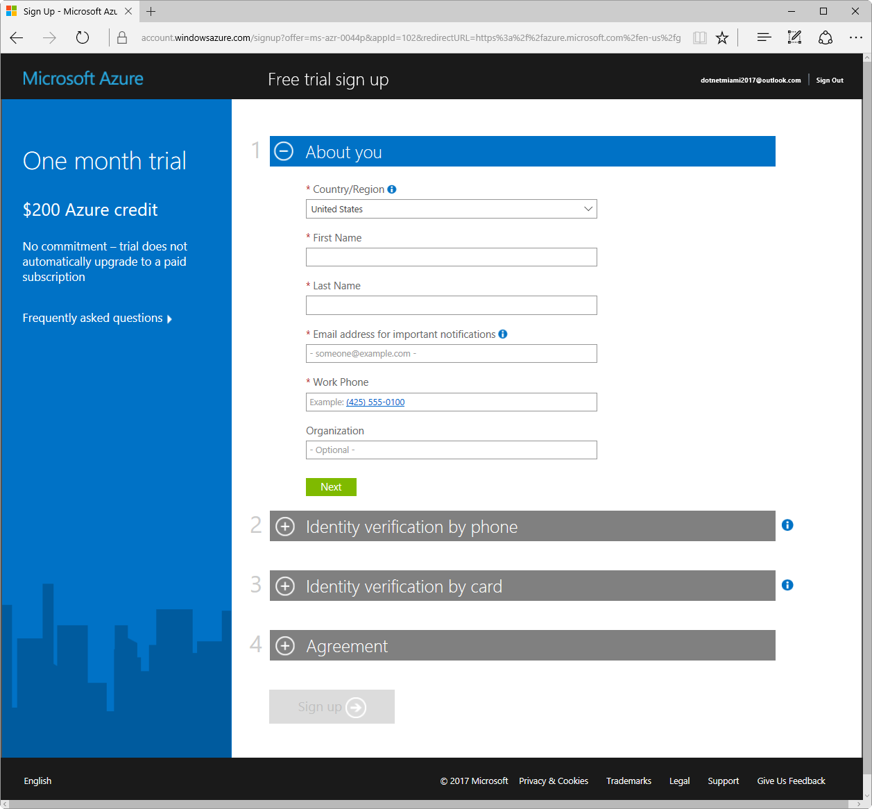

Slide 4
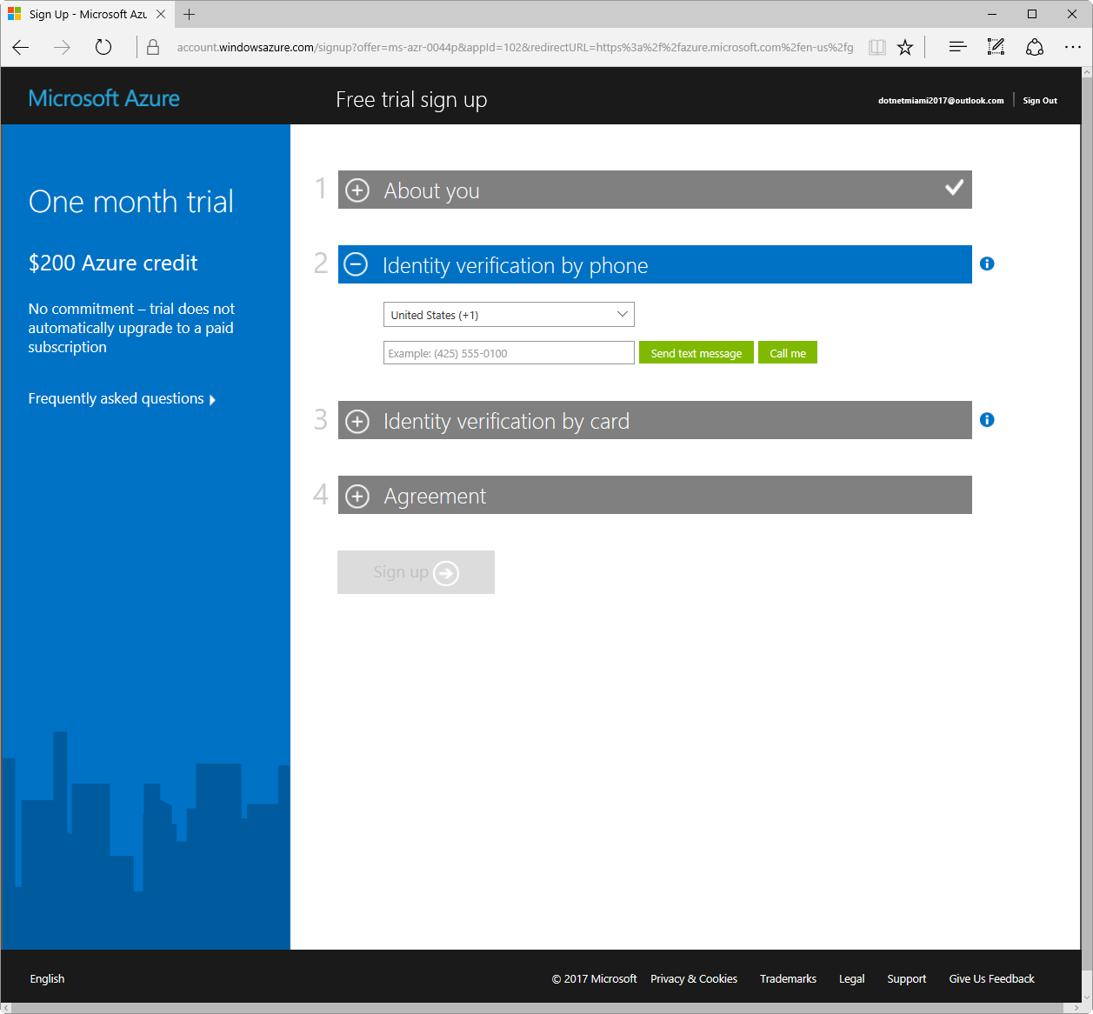

Slide 5
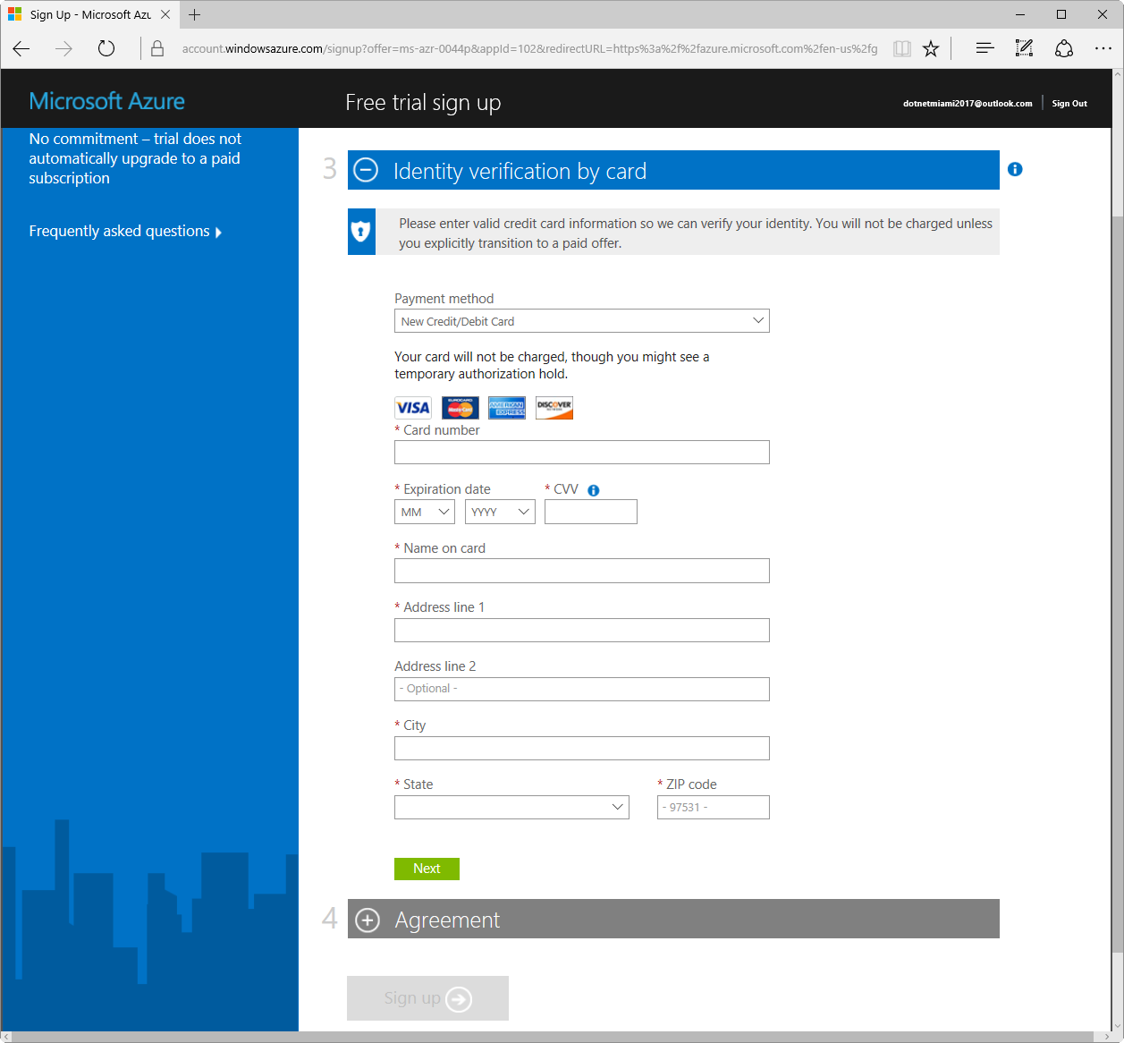

Slide 6
